Slide 1
Data Structures
Lecture#2

Slide 2
Class vs object
Class:
Common Noun
Object:
Proper Noun
Example:
Teacher ------------Class
Teacher Shahida-----------Object

Slide 3
Class
Class is a group of variables and functions
Class is a way to implement encapsulation.
A single class can have multiple objects.

Slide 4
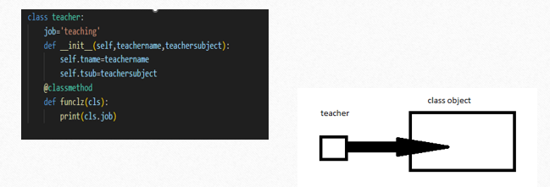
Class (cont…)
A class has only one class object but can has any number of instance objects.

Slide 5
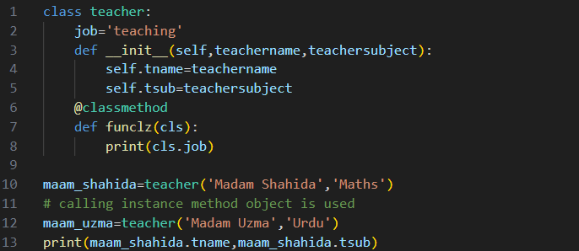
Class object variable
Note:
Here “job” is the class object variable
It is also known as static variable.
You can’t define the instance object variable within the body of class directly.
In java or C++ you have to explicitly mention a key word “static ”to define a class object variable otherwise that is considered as an instance object variables.

Slide 6
Instance object variable
A special function defined within a class body know as init() function.
You must have at least one argument in the init fun() i.e. “self”
Self must be first argument.
init() is called automatically whenever you create an instance object.

Slide 7
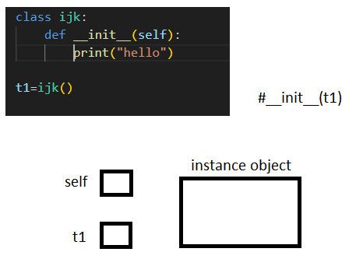
Importance of self argument
t1 is passed to self as an argument
That’s why to pass at least one argument is essential.
The reference hold by the t1 is passed to self

Slide 8
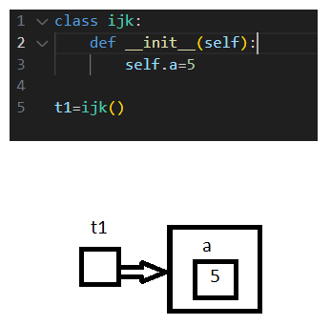
Accessing instance object members
Here “a” is the instance object variable.

Slide 9
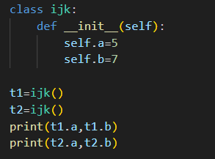

Accessing instance object members(cont…)
Result:

Slide 10
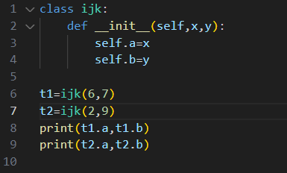

Additional arguments in init()
Result:

